Slide 1
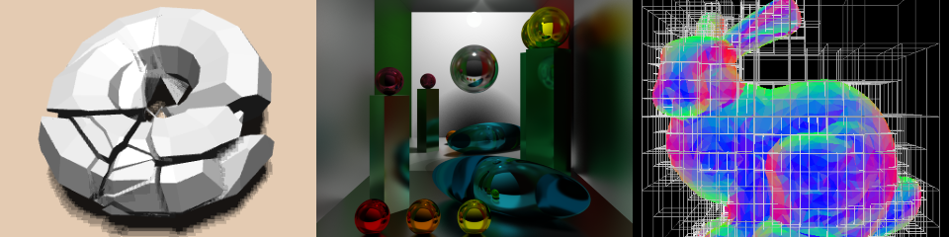
Ray Marching
Patrick Cozzi
University of Pennsylvania
CIS 565 - Fall 2015

Slide 2
Acknowledgments
Numerical Methods for Ray Tracing Implicitly Defined Surfaces by Morgan McGuire
Rendering Worlds with Two Triangles with raytracing on the GPU in 4096 bytes by Inigo Quilez
Distance function examples by Inigo Quilez
Notes:
http://graphics.cs.williams.edu/courses/cs371/f14/reading/implicit.pdf
http://www.iquilezles.org/www/material/nvscene2008/rwwtt.pdf
https://www.shadertoy.com/view/Xds3zN

Slide 3
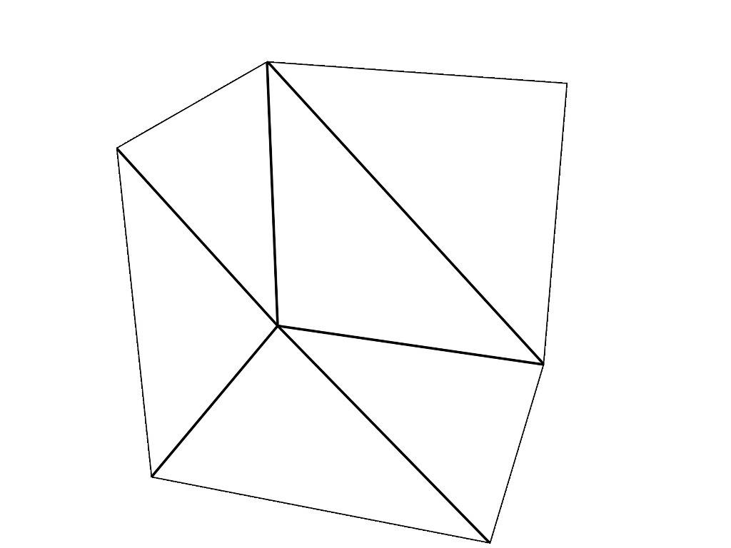
Ray Casting in a Fragment Shader
Figure from http://virtualglobebook.com/
Notes:
Code: https://github.com/virtualglobebook/OpenGlobe/tree/master/Source/Scene/Globes/RayCasted/Shaders

Slide 4
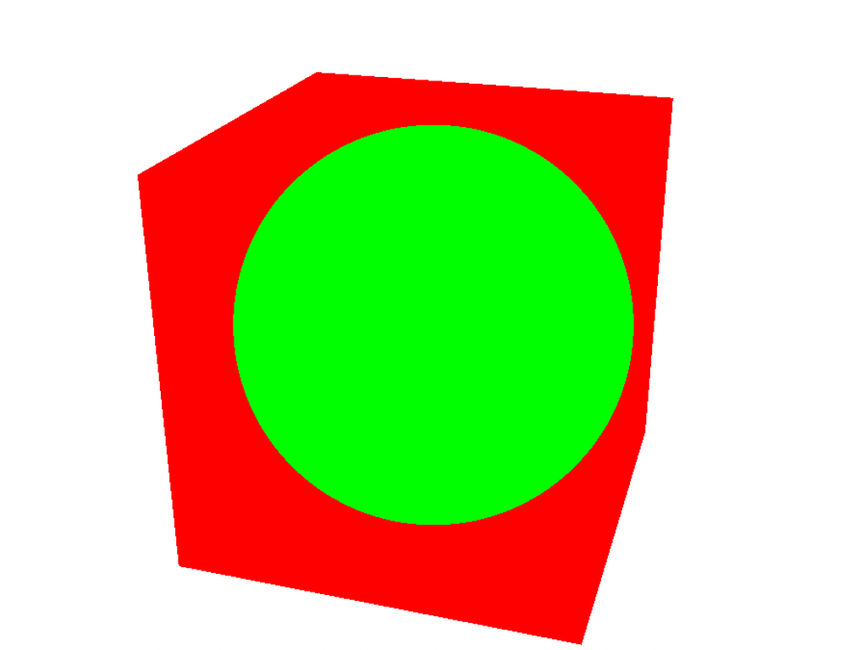
Ray Casting in a Fragment Shader
Figure from http://virtualglobebook.com/

Slide 5
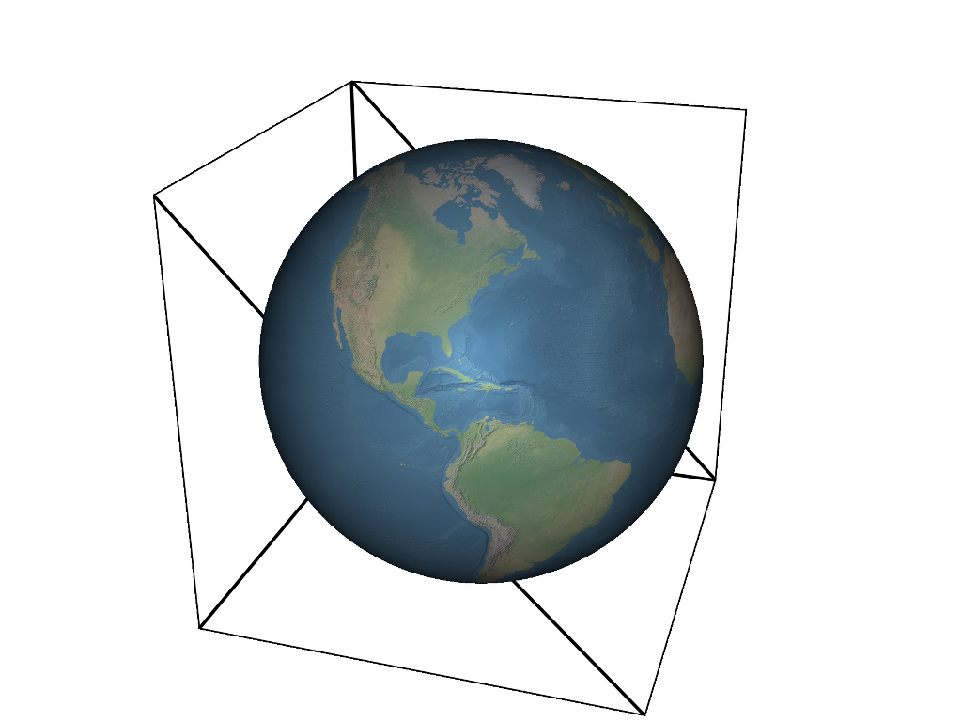
Ray Casting in a Fragment Shader
Figure from http://virtualglobebook.com/

Slide 6
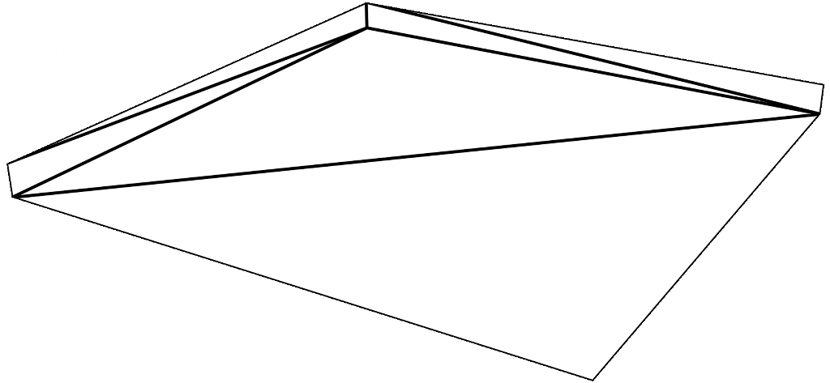
Ray Marching in a Fragment Shader
Figure from http://virtualglobebook.com/
Notes:
Code: https://github.com/virtualglobebook/OpenGlobe/tree/master/Source/Scene/Terrain/RayCastedTerrainTile

Slide 7
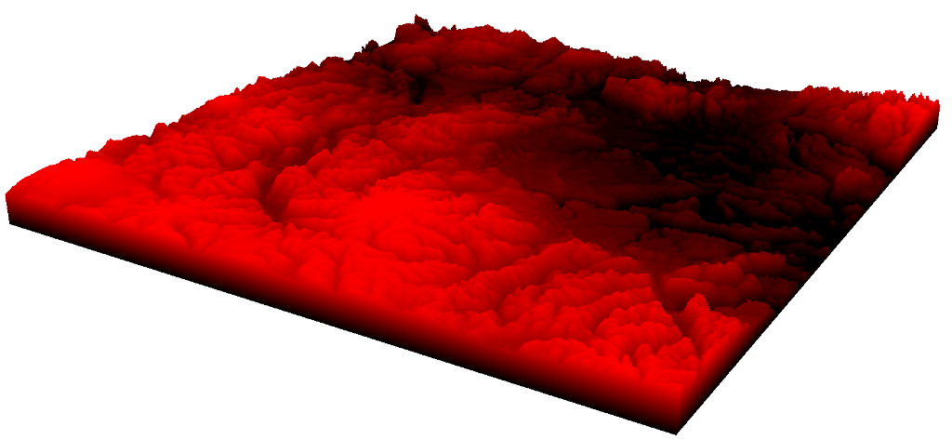
Ray Marching in a Fragment Shader
Figure from http://virtualglobebook.com/

Slide 8
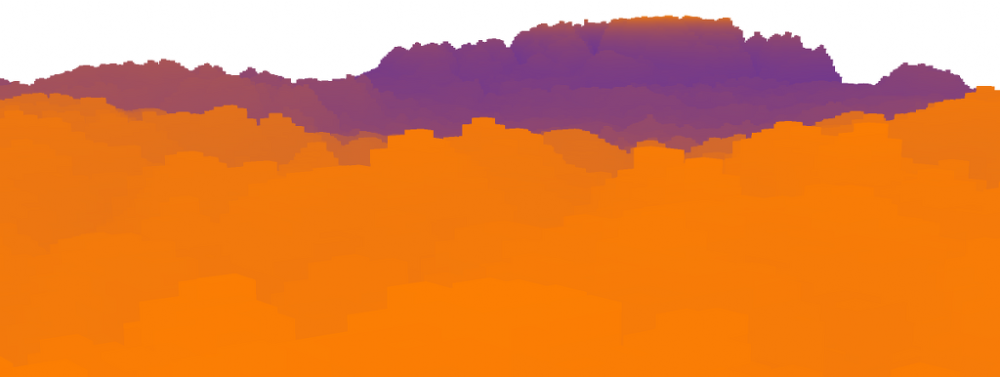
Ray Marching in a Fragment Shader
Figure from http://virtualglobebook.com/

Slide 9
Ray Marching with Distance Functions
Two triangles (or one)
  No explicit geometry
Ray cast in the fragment shader
  Each happens in parallel
Take big steps along the ray
Distance function returns the minimum distance to a surface from a point

Slide 10
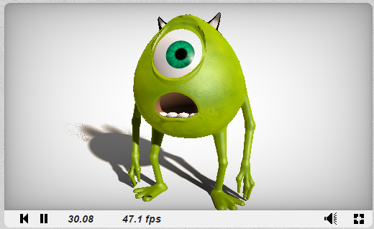
Ray Marching with Distance Functions
Screenshot from https://www.shadertoy.com/view/MsXGWr
Notes:
https://www.shadertoy.com/view/MsXGWr

Slide 11
Ray Marching Example
Ray:
Sphere:
Root equation:
  t is only variable
Example for numerical ray intersection
    (Yes, this also has an analytic solution)
Equations from http://graphics.cs.williams.edu/courses/cs371/f14/reading/implicit.pdf
Notes:
Ray equation is explicit. Sphere equation is implicit.
Substitute explicit equation into implicit one and solve for t. Same as finding the roots.
P – ray origin
w – ray direction
t – “time” along ray
X – point on sphere
C – center of sphere
g(t) = 0 at surface

Slide 12
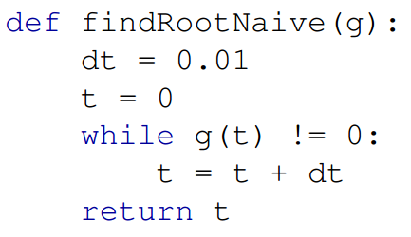
Ray Marching: First Try
Code from http://graphics.cs.williams.edu/courses/cs371/f14/reading/implicit.pdf
Notes:
Likely loops forever.
Ray intersecting the surface likely won’t hit exactly g(t) == 0.
Some rays won’t intersect the surface.

Slide 13
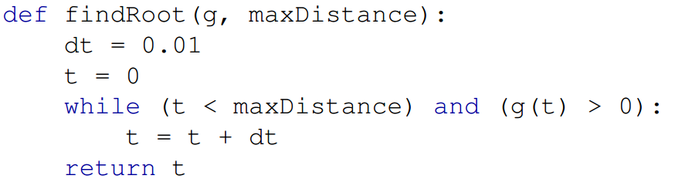
Ray Marching: Fixed Steps
Code from http://graphics.cs.williams.edu/courses/cs371/f14/reading/implicit.pdf
Notes:
Adds
Max distance bound
Check when g cross from + to 0/-
Could also binary search in the final [t_n-1, t_n] interval to fine a closer t.

Slide 14
Ray Marching with Fixed Steps
Advantages (over analytic intersection)
  Simple to implement
  Works for any implicitly defined surface
  Extends to participating media
Disadvantages
  Can miss non-convex geometry
  Linear time instead of constant
Notes:
Integration of scattering in participating media such as fog.
If the step size is huge, it could miss convex geometry too.
Ray hits surface: linear in the distance to the surface. Ray misses: linear in the maximum distance.

Slide 15
Signed Distance Functions
The function, h(X), is
  + outside the surface
  0 at the surface
  - inside the surface
h(X) <= distance to the surface
Requires embedded manifold without boundary
+
0
-
Notes:
g(t) = 0 at the surface (and g(t) > 0 at ray origin, and g is continuous). h(X) provides more to allow sphere tracing

Slide 16
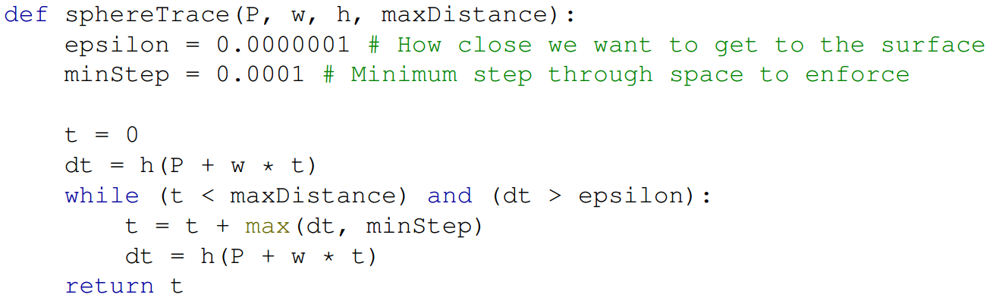
Ray Marching: Sphere Tracing
Code from http://graphics.cs.williams.edu/courses/cs371/f14/reading/implicit.pdf

Slide 17
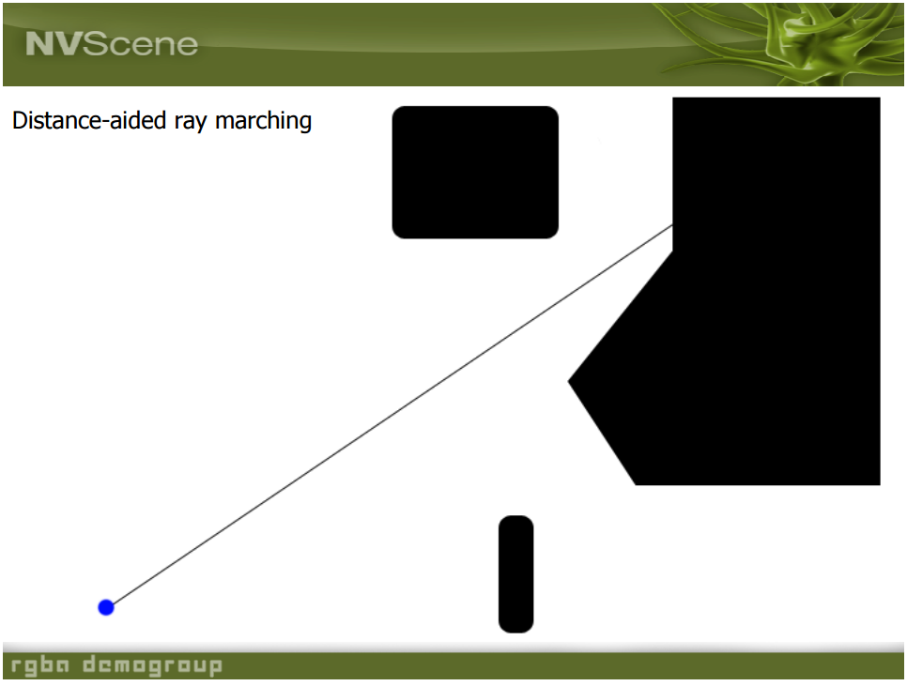
Slide from http://www.iquilezles.org/www/material/nvscene2008/rwwtt.pdf

Slide 18
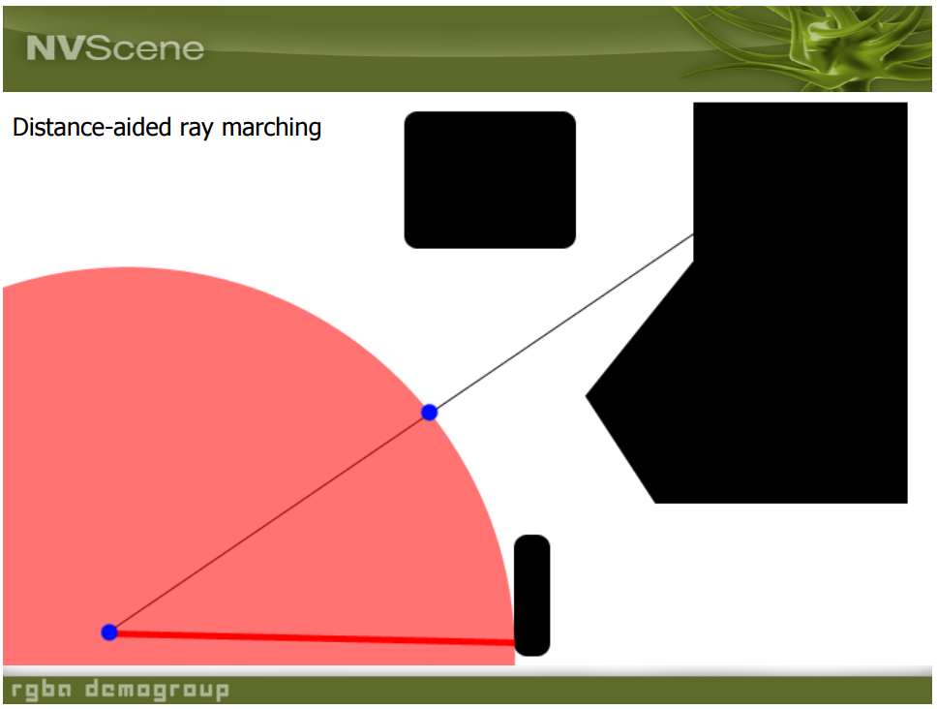
Slide from http://www.iquilezles.org/www/material/nvscene2008/rwwtt.pdf

Slide 19
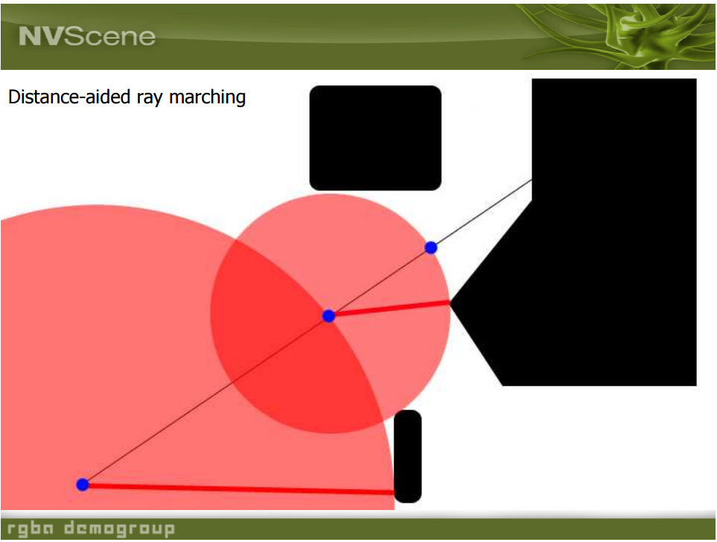
Slide from http://www.iquilezles.org/www/material/nvscene2008/rwwtt.pdf

Slide 20
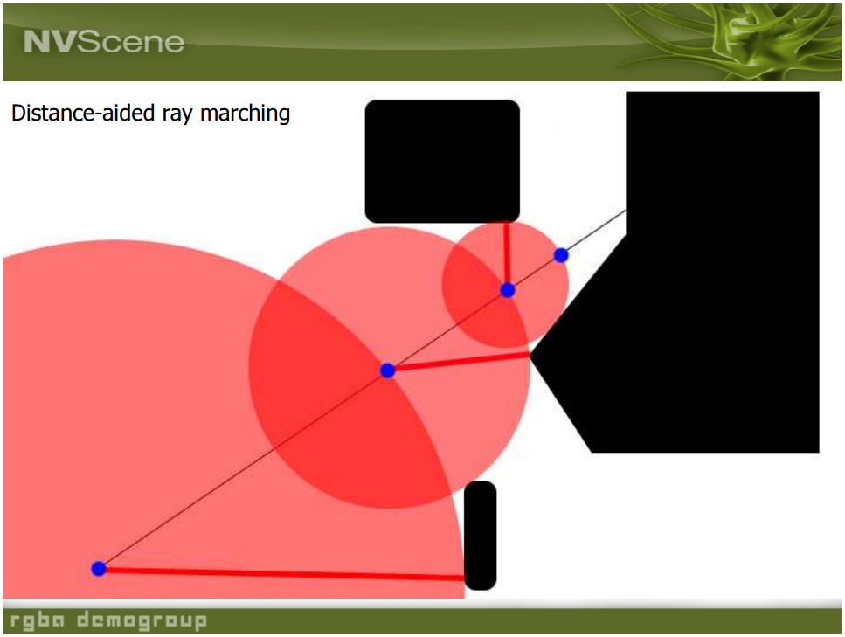
Slide from http://www.iquilezles.org/www/material/nvscene2008/rwwtt.pdf

Slide 21
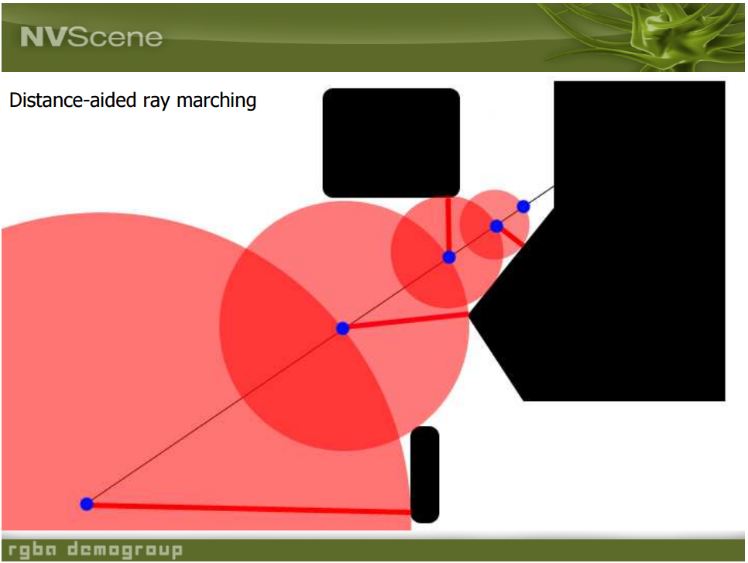
Slide from http://www.iquilezles.org/www/material/nvscene2008/rwwtt.pdf

Slide 22

Slide from http://www.iquilezles.org/www/material/nvscene2008/rwwtt.pdf

Slide 23

Slide from http://www.iquilezles.org/www/material/nvscene2008/rwwtt.pdf

Slide 24
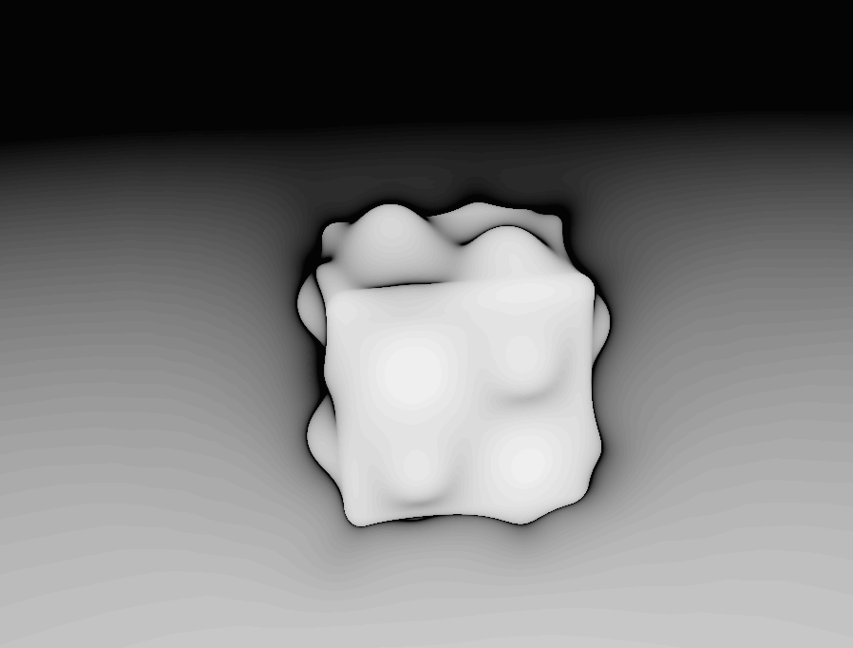
Slow on boundaries
Slide from http://www.iamnop.com/raymarch/
Notes:
Shaded by number of steps

Slide 25
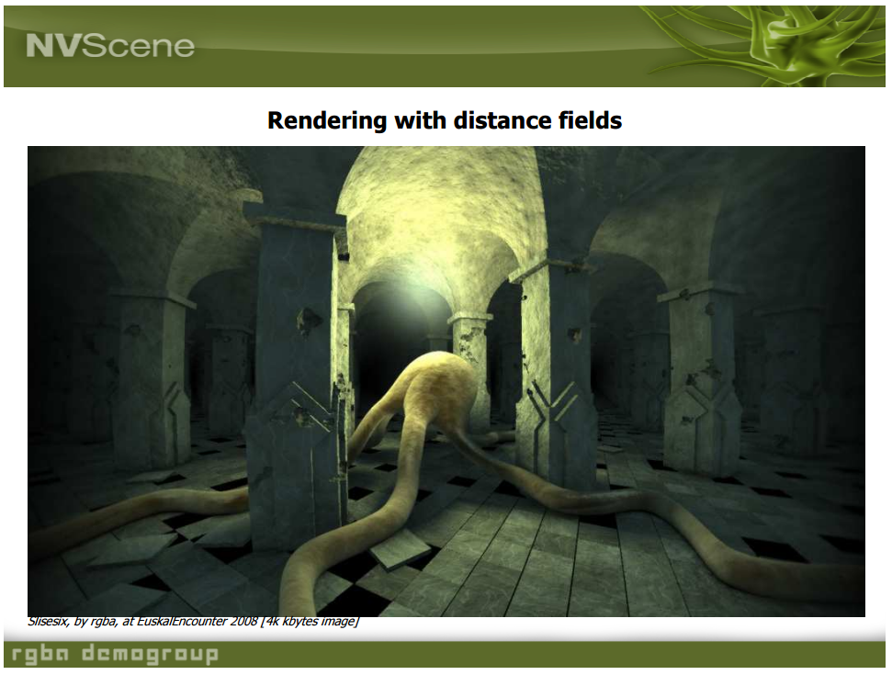
Slide from http://www.iquilezles.org/www/material/nvscene2008/rwwtt.pdf

Slide 26
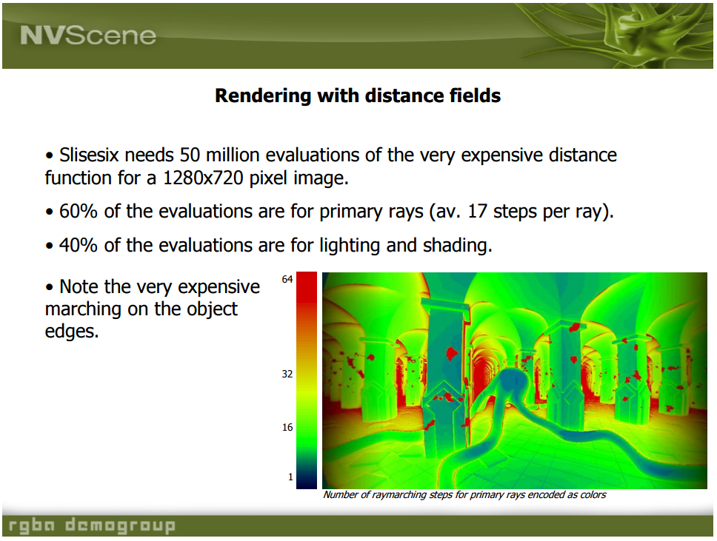
Slide from http://www.iquilezles.org/www/material/nvscene2008/rwwtt.pdf

Slide 27
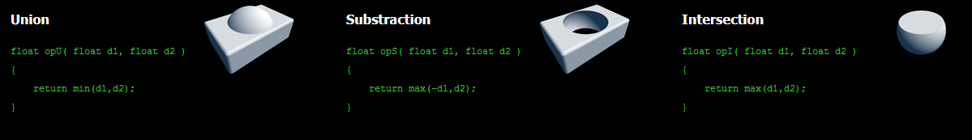
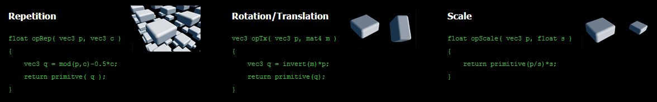
Operators
Content from http://www.iquilezles.org/www/articles/distfunctions/distfunctions.htm
Notes:
d1 and d2 are distances returned from the distance functions.
c is count. primitive() is any distance function or composite of distance functions.

Slide 28
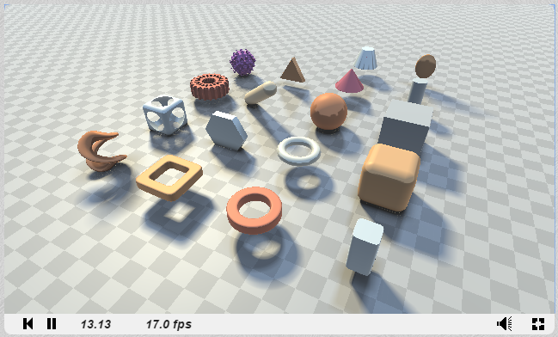
Distance Functions Reference
https://www.shadertoy.com/view/Xds3zN
By Inigo Quilez

Slide 29

Shading with Ray Marching
Compute the normal
Then apply the lighting model and use secondary rays for effects
Equation from http://graphics.cs.williams.edu/courses/cs371/f14/reading/implicit.pdf
Notes:
Compute gradient with numerical differentiation.

Slide 30
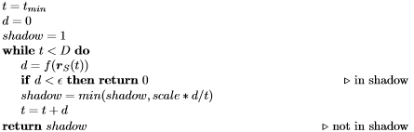
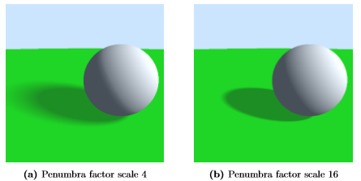
Soft Shadows
Content from http://www2.compute.dtu.dk/pubdb/views/edoc_download.php/6392/pdf/imm6392.pdf
Notes:
Section 3.4

Slide 31
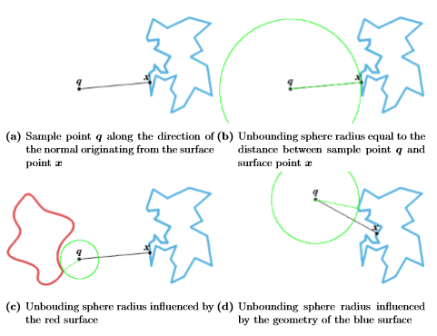

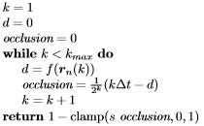
Ambient Occlusion
Content from http://www2.compute.dtu.dk/pubdb/views/edoc_download.php/6392/pdf/imm6392.pdf
Notes:
Bottom of Page 32

Slide 32
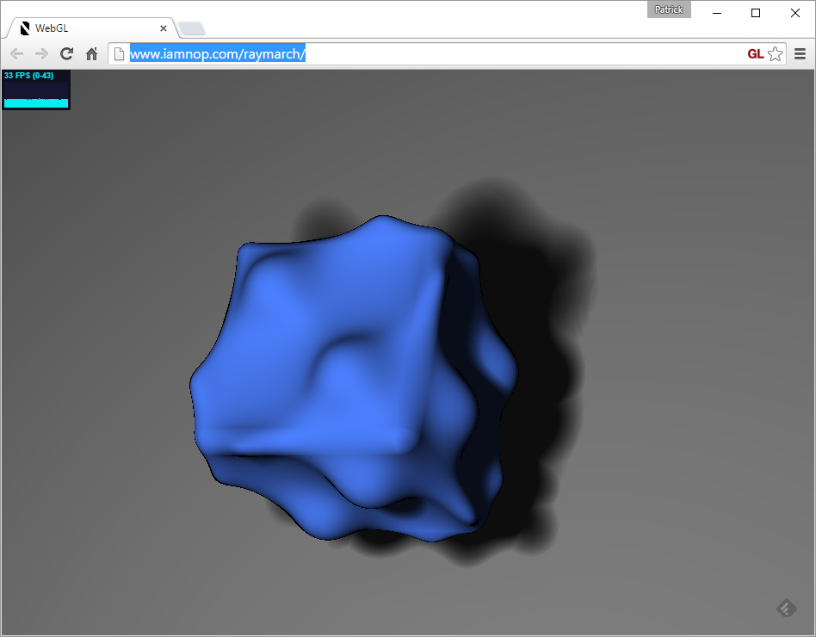
Spring 2011 - Nop Jiarathanakul
http://www.iamnop.com/raymarch/
Notes:
This was a final project – now it is a one week project.
Demo: http://www.iamnop.com/raymarch/
http://nopjia.blogspot.com/2012/04/final-deliverables.html

Slide 33
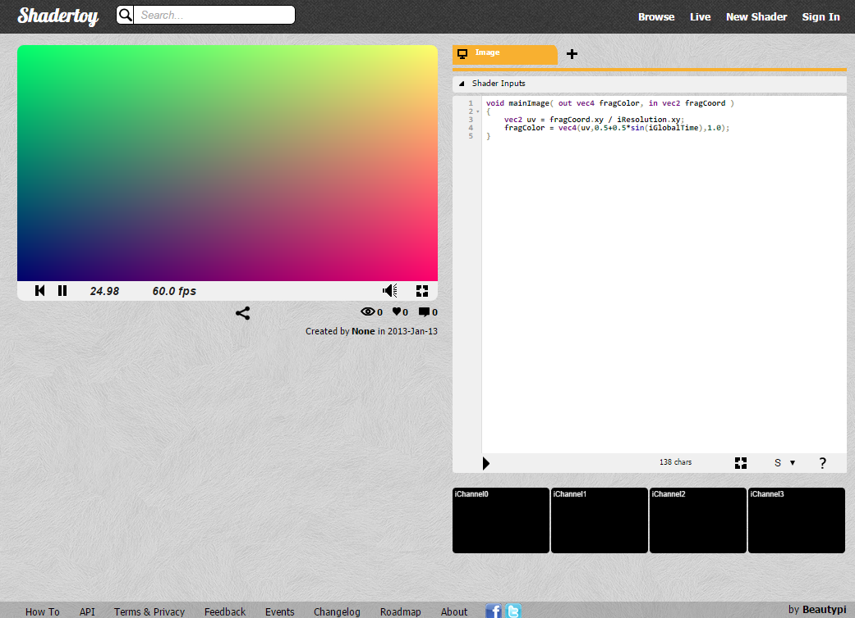
Getting Started with Shadertoy
https://www.shadertoy.com/new
Notes:
https://www.shadertoy.com/new
---
void mainImage( out vec4 fragColor, in vec2 fragCoord )
{
vec2 uv = fragCoord.xy / iResolution.xy;
fragColor = texture2D(iChannel0, uv);
}

Slide 34
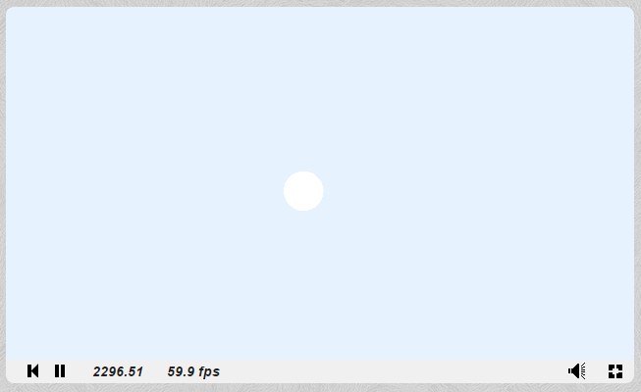
A sphere
Code is in the slide notes
Notes:
The following code is a trimmed down version of iq’s reference, https://www.shadertoy.com/view/Xds3zN. Copy and paste it into ShaderToy: https://www.shadertoy.com/new
---
// Created by inigo quilez - iq/2013
// License Creative Commons Attribution-NonCommercial-ShareAlike 3.0 Unported License.
// A list of usefull distance function to simple primitives, and an example on how to
// do some interesting boolean operations, repetition and displacement.
//
// More info here: http://www.iquilezles.org/www/articles/distfunctions/distfunctions.htm
float sdSphere( vec3 p, float s )
{
return length(p)-s;
}
//----------------------------------------------------------------------
vec2 map( in vec3 pos )
{
return vec2( sdSphere( pos-vec3( 0.0,0.25, 0.0), 0.25 ), 46.9 );
}
vec2 castRay( in vec3 ro, in vec3 rd )
{
float tmin = 1.0;
float tmax = 20.0;
float precis = 0.002;
float t = tmin;
float m = -1.0;
for( int i=0; i<50; i++ )
{
vec2 res = map( ro+rd*t );
if( res.x<precis || t>tmax ) break;
t += res.x;
m = res.y;
}
if( t>tmax ) m=-1.0;
return vec2( t, m );
}
vec3 render( in vec3 ro, in vec3 rd )
{
vec3 col = vec3(0.8, 0.9, 1.0); // Sky color
vec2 res = castRay(ro,rd);
float t = res.x;
float m = res.y;
if( m>-0.5 ) // Ray intersects a surface
{
col = vec3(1.0); // Sphere color
}
return vec3( clamp(col,0.0,1.0) );
}
mat3 setCamera( in vec3 ro, in vec3 ta, float cr )
{
vec3 cw = normalize(ta-ro);
vec3 cp = vec3(sin(cr), cos(cr),0.0);
vec3 cu = normalize( cross(cw,cp) );
vec3 cv = normalize( cross(cu,cw) );
return mat3( cu, cv, cw );
}
void mainImage( out vec4 fragColor, in vec2 fragCoord )
{
vec2 q = fragCoord.xy/iResolution.xy;
vec2 p = -1.0+2.0*q;
p.x *= iResolution.x/iResolution.y;
vec2 mo = iMouse.xy/iResolution.xy;
float time = 15.0 + iGlobalTime;
// camera
vec3 ro = vec3( -0.5+3.5*cos(0.1*time + 6.0*mo.x), 1.0 + 2.0*mo.y, 0.5 + 3.5*sin(0.1*time + 6.0*mo.x) );
vec3 ta = vec3( -0.5, -0.4, 0.5 );
// camera-to-world transformation
mat3 ca = setCamera( ro, ta, 0.0 );
// ray direction
vec3 rd = ca * normalize( vec3(p.xy,2.0) );
// render
vec3 col = render( ro, rd );
col = pow( col, vec3(0.4545) ); // Gamma correct
fragColor=vec4( col, 1.0 );
}

Slide 35
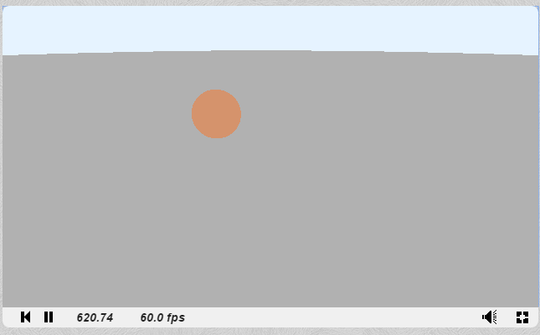
A sphere and a plane
Code is in the slide notes
Notes:
The following code is a trimmed down version of iq’s reference, https://www.shadertoy.com/view/Xds3zN. Copy and paste it into ShaderToy: https://www.shadertoy.com/new
---
// Created by inigo quilez - iq/2013
// License Creative Commons Attribution-NonCommercial-ShareAlike 3.0 Unported License.
// A list of usefull distance function to simple primitives, and an example on how to
// do some interesting boolean operations, repetition and displacement.
//
// More info here: http://www.iquilezles.org/www/articles/distfunctions/distfunctions.htm
float sdPlane( vec3 p )
{
return p.y;
}
float sdSphere( vec3 p, float s )
{
return length(p)-s;
}
//----------------------------------------------------------------------
vec2 opU( vec2 d1, vec2 d2 )
{
return (d1.x<d2.x) ? d1 : d2;
}
//----------------------------------------------------------------------
vec2 map( in vec3 pos )
{
vec2 res = opU( vec2( sdPlane( pos), 1.0 ),
vec2( sdSphere( pos-vec3( 0.0,0.25, 0.0), 0.25 ), 46.9 ) );
return res;
}
vec2 castRay( in vec3 ro, in vec3 rd )
{
float tmin = 1.0;
float tmax = 20.0;
float precis = 0.002;
float t = tmin;
float m = -1.0;
for( int i=0; i<50; i++ )
{
vec2 res = map( ro+rd*t );
if( res.x<precis || t>tmax ) break;
t += res.x;
m = res.y;
}
if( t>tmax ) m=-1.0;
return vec2( t, m );
}
vec3 render( in vec3 ro, in vec3 rd )
{
vec3 col = vec3(0.8, 0.9, 1.0); // Sky color
vec2 res = castRay(ro,rd);
float t = res.x;
float m = res.y;
if( m>-0.5 ) // Ray intersects a surface
{
vec3 pos = ro + t*rd;
// material
col = 0.45 + 0.3*sin( vec3(0.05,0.08,0.10)*(m-1.0) );
}
return vec3( clamp(col,0.0,1.0) );
}
mat3 setCamera( in vec3 ro, in vec3 ta, float cr )
{
vec3 cw = normalize(ta-ro);
vec3 cp = vec3(sin(cr), cos(cr),0.0);
vec3 cu = normalize( cross(cw,cp) );
vec3 cv = normalize( cross(cu,cw) );
return mat3( cu, cv, cw );
}
void mainImage( out vec4 fragColor, in vec2 fragCoord )
{
vec2 q = fragCoord.xy/iResolution.xy;
vec2 p = -1.0+2.0*q;
p.x *= iResolution.x/iResolution.y;
vec2 mo = iMouse.xy/iResolution.xy;
float time = 15.0 + iGlobalTime;
// camera
vec3 ro = vec3( -0.5+3.5*cos(0.1*time + 6.0*mo.x), 1.0 + 2.0*mo.y, 0.5 + 3.5*sin(0.1*time + 6.0*mo.x) );
vec3 ta = vec3( -0.5, -0.4, 0.5 );
// camera-to-world transformation
mat3 ca = setCamera( ro, ta, 0.0 );
// ray direction
vec3 rd = ca * normalize( vec3(p.xy,2.0) );
// render
vec3 col = render( ro, rd );
col = pow( col, vec3(0.4545) ); // Gamma correct
fragColor=vec4( col, 1.0 );
}

Slide 36
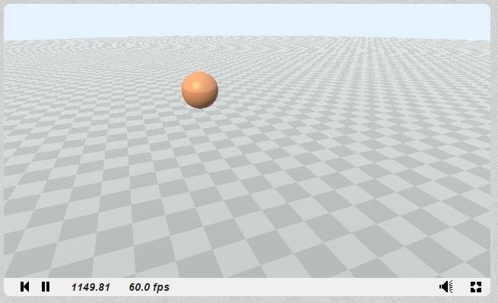
With Lighting
Code is in the slide notes
Notes:
The following code is a trimmed down version of iq’s reference, https://www.shadertoy.com/view/Xds3zN. Copy and paste it into ShaderToy: https://www.shadertoy.com/new
---
// Created by inigo quilez - iq/2013
// License Creative Commons Attribution-NonCommercial-ShareAlike 3.0 Unported License.
// A list of usefull distance function to simple primitives, and an example on how to
// do some interesting boolean operations, repetition and displacement.
//
// More info here: http://www.iquilezles.org/www/articles/distfunctions/distfunctions.htm
float sdPlane( vec3 p )
{
return p.y;
}
float sdSphere( vec3 p, float s )
{
return length(p)-s;
}
//----------------------------------------------------------------------
vec2 opU( vec2 d1, vec2 d2 )
{
return (d1.x<d2.x) ? d1 : d2;
}
//----------------------------------------------------------------------
vec2 map( in vec3 pos )
{
vec2 res = opU( vec2( sdPlane( pos), 1.0 ),
vec2( sdSphere( pos-vec3( 0.0,0.25, 0.0), 0.25 ), 46.9 ) );
return res;
}
vec2 castRay( in vec3 ro, in vec3 rd )
{
float tmin = 1.0;
float tmax = 20.0;
float precis = 0.002;
float t = tmin;
float m = -1.0;
for( int i=0; i<50; i++ )
{
vec2 res = map( ro+rd*t );
if( res.x<precis || t>tmax ) break;
t += res.x;
m = res.y;
}
if( t>tmax ) m=-1.0;
return vec2( t, m );
}
vec3 calcNormal( in vec3 pos )
{
vec3 eps = vec3( 0.001, 0.0, 0.0 );
vec3 nor = vec3(
map(pos+eps.xyy).x - map(pos-eps.xyy).x,
map(pos+eps.yxy).x - map(pos-eps.yxy).x,
map(pos+eps.yyx).x - map(pos-eps.yyx).x );
return normalize(nor);
}
vec3 render( in vec3 ro, in vec3 rd )
{
vec3 col = vec3(0.8, 0.9, 1.0); // Sky color
vec2 res = castRay(ro,rd);
float t = res.x;
float m = res.y;
if( m>-0.5 ) // Ray intersects a surface
{
vec3 pos = ro + t*rd;
vec3 nor = calcNormal( pos );
vec3 ref = reflect( rd, nor );
// material
col = 0.45 + 0.3*sin( vec3(0.05,0.08,0.10)*(m-1.0) );
if( m<1.5 )
{
float f = mod( floor(5.0*pos.z) + floor(5.0*pos.x), 2.0);
col = 0.4 + 0.1*f*vec3(1.0);
}
// lighitng
vec3 lig = normalize( vec3(-0.6, 0.7, -0.5) );
float amb = clamp( 0.5+0.5*nor.y, 0.0, 1.0 );
float dif = clamp( dot( nor, lig ), 0.0, 1.0 );
float bac = clamp( dot( nor, normalize(vec3(-lig.x,0.0,-lig.z))), 0.0, 1.0 )*clamp( 1.0-pos.y,0.0,1.0);
float dom = smoothstep( -0.1, 0.1, ref.y );
float fre = pow( clamp(1.0+dot(nor,rd),0.0,1.0), 2.0 );
float spe = pow(clamp( dot( ref, lig ), 0.0, 1.0 ),16.0);
vec3 brdf = vec3(0.0);
brdf += 1.20*dif*vec3(1.00,0.90,0.60);
brdf += 1.20*spe*vec3(1.00,0.90,0.60)*dif;
brdf += 0.30*amb*vec3(0.50,0.70,1.00);//*occ;
brdf += 0.40*dom*vec3(0.50,0.70,1.00);//*occ;
brdf += 0.30*bac*vec3(0.25,0.25,0.25);//*occ;
brdf += 0.40*fre*vec3(1.00,1.00,1.00);//*occ;
brdf += 0.02;
col = col*brdf;
col = mix( col, vec3(0.8,0.9,1.0), 1.0-exp( -0.0005*t*t ) );
}
return vec3( clamp(col,0.0,1.0) );
}
mat3 setCamera( in vec3 ro, in vec3 ta, float cr )
{
vec3 cw = normalize(ta-ro);
vec3 cp = vec3(sin(cr), cos(cr),0.0);
vec3 cu = normalize( cross(cw,cp) );
vec3 cv = normalize( cross(cu,cw) );
return mat3( cu, cv, cw );
}
void mainImage( out vec4 fragColor, in vec2 fragCoord )
{
vec2 q = fragCoord.xy/iResolution.xy;
vec2 p = -1.0+2.0*q;
p.x *= iResolution.x/iResolution.y;
vec2 mo = iMouse.xy/iResolution.xy;
float time = 15.0 + iGlobalTime;
// camera
vec3 ro = vec3( -0.5+3.5*cos(0.1*time + 6.0*mo.x), 1.0 + 2.0*mo.y, 0.5 + 3.5*sin(0.1*time + 6.0*mo.x) );
vec3 ta = vec3( -0.5, -0.4, 0.5 );
// camera-to-world transformation
mat3 ca = setCamera( ro, ta, 0.0 );
// ray direction
vec3 rd = ca * normalize( vec3(p.xy,2.0) );
// render
vec3 col = render( ro, rd );
col = pow( col, vec3(0.4545) ); // Gamma correct
fragColor=vec4( col, 1.0 );
}

Slide 37
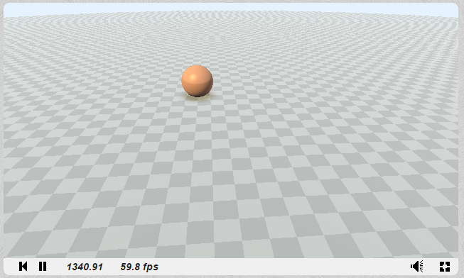
With Ambient Occlusion
Code is in the slide notes
Notes:
The following code is a trimmed down version of iq’s reference, https://www.shadertoy.com/view/Xds3zN. Copy and paste it into ShaderToy: https://www.shadertoy.com/new
---
// Created by inigo quilez - iq/2013
// License Creative Commons Attribution-NonCommercial-ShareAlike 3.0 Unported License.
// A list of usefull distance function to simple primitives, and an example on how to
// do some interesting boolean operations, repetition and displacement.
//
// More info here: http://www.iquilezles.org/www/articles/distfunctions/distfunctions.htm
float sdPlane( vec3 p )
{
return p.y;
}
float sdSphere( vec3 p, float s )
{
return length(p)-s;
}
//----------------------------------------------------------------------
vec2 opU( vec2 d1, vec2 d2 )
{
return (d1.x<d2.x) ? d1 : d2;
}
//----------------------------------------------------------------------
vec2 map( in vec3 pos )
{
vec2 res = opU( vec2( sdPlane( pos), 1.0 ),
vec2( sdSphere( pos-vec3( 0.0,0.25, 0.0), 0.25 ), 46.9 ) );
return res;
}
vec2 castRay( in vec3 ro, in vec3 rd )
{
float tmin = 1.0;
float tmax = 20.0;
float precis = 0.002;
float t = tmin;
float m = -1.0;
for( int i=0; i<50; i++ )
{
vec2 res = map( ro+rd*t );
if( res.x<precis || t>tmax ) break;
t += res.x;
m = res.y;
}
if( t>tmax ) m=-1.0;
return vec2( t, m );
}
vec3 calcNormal( in vec3 pos )
{
vec3 eps = vec3( 0.001, 0.0, 0.0 );
vec3 nor = vec3(
map(pos+eps.xyy).x - map(pos-eps.xyy).x,
map(pos+eps.yxy).x - map(pos-eps.yxy).x,
map(pos+eps.yyx).x - map(pos-eps.yyx).x );
return normalize(nor);
}
float calcAO( in vec3 pos, in vec3 nor )
{
float occ = 0.0;
float sca = 1.0;
for( int i=0; i<5; i++ )
{
float hr = 0.01 + 0.12*float(i)/4.0;
vec3 aopos = nor * hr + pos;
float dd = map( aopos ).x;
occ += -(dd-hr)*sca;
sca *= 0.95;
}
return clamp( 1.0 - 3.0*occ, 0.0, 1.0 );
}
vec3 render( in vec3 ro, in vec3 rd )
{
vec3 col = vec3(0.8, 0.9, 1.0); // Sky color
vec2 res = castRay(ro,rd);
float t = res.x;
float m = res.y;
if( m>-0.5 ) // Ray intersects a surface
{
vec3 pos = ro + t*rd;
vec3 nor = calcNormal( pos );
vec3 ref = reflect( rd, nor );
// material
col = 0.45 + 0.3*sin( vec3(0.05,0.08,0.10)*(m-1.0) );
if( m<1.5 )
{
float f = mod( floor(5.0*pos.z) + floor(5.0*pos.x), 2.0);
col = 0.4 + 0.1*f*vec3(1.0);
}
// lighitng
float occ = calcAO( pos, nor );
vec3 lig = normalize( vec3(-0.6, 0.7, -0.5) );
float amb = clamp( 0.5+0.5*nor.y, 0.0, 1.0 );
float dif = clamp( dot( nor, lig ), 0.0, 1.0 );
float bac = clamp( dot( nor, normalize(vec3(-lig.x,0.0,-lig.z))), 0.0, 1.0 )*clamp( 1.0-pos.y,0.0,1.0);
float dom = smoothstep( -0.1, 0.1, ref.y );
float fre = pow( clamp(1.0+dot(nor,rd),0.0,1.0), 2.0 );
float spe = pow(clamp( dot( ref, lig ), 0.0, 1.0 ),16.0);
vec3 brdf = vec3(0.0);
brdf += 1.20*dif*vec3(1.00,0.90,0.60);
brdf += 1.20*spe*vec3(1.00,0.90,0.60)*dif;
brdf += 0.30*amb*vec3(0.50,0.70,1.00)*occ;
brdf += 0.40*dom*vec3(0.50,0.70,1.00)*occ;
brdf += 0.30*bac*vec3(0.25,0.25,0.25)*occ;
brdf += 0.40*fre*vec3(1.00,1.00,1.00)*occ;
brdf += 0.02;
col = col*brdf;
col = mix( col, vec3(0.8,0.9,1.0), 1.0-exp( -0.0005*t*t ) );
}
return vec3( clamp(col,0.0,1.0) );
}
mat3 setCamera( in vec3 ro, in vec3 ta, float cr )
{
vec3 cw = normalize(ta-ro);
vec3 cp = vec3(sin(cr), cos(cr),0.0);
vec3 cu = normalize( cross(cw,cp) );
vec3 cv = normalize( cross(cu,cw) );
return mat3( cu, cv, cw );
}
void mainImage( out vec4 fragColor, in vec2 fragCoord )
{
vec2 q = fragCoord.xy/iResolution.xy;
vec2 p = -1.0+2.0*q;
p.x *= iResolution.x/iResolution.y;
vec2 mo = iMouse.xy/iResolution.xy;
float time = 15.0 + iGlobalTime;
// camera
vec3 ro = vec3( -0.5+3.5*cos(0.1*time + 6.0*mo.x), 1.0 + 2.0*mo.y, 0.5 + 3.5*sin(0.1*time + 6.0*mo.x) );
vec3 ta = vec3( -0.5, -0.4, 0.5 );
// camera-to-world transformation
mat3 ca = setCamera( ro, ta, 0.0 );
// ray direction
vec3 rd = ca * normalize( vec3(p.xy,2.0) );
// render
vec3 col = render( ro, rd );
col = pow( col, vec3(0.4545) ); // Gamma correct
fragColor=vec4( col, 1.0 );
}

Slide 38
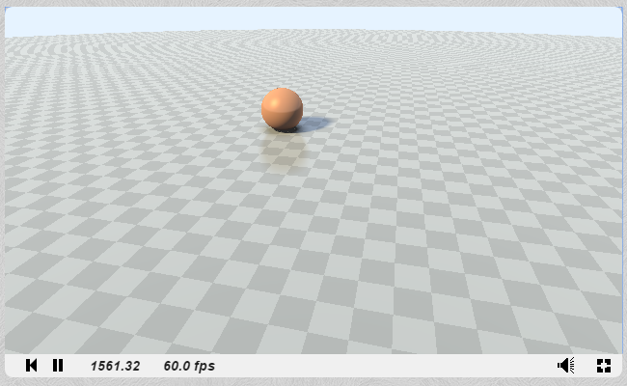
With Soft Shadows
Code is in the slide notes
Notes:
The following code is a trimmed down version of iq’s reference, https://www.shadertoy.com/view/Xds3zN. Copy and paste it into ShaderToy: https://www.shadertoy.com/new
---
// Created by inigo quilez - iq/2013
// License Creative Commons Attribution-NonCommercial-ShareAlike 3.0 Unported License.
// A list of usefull distance function to simple primitives, and an example on how to
// do some interesting boolean operations, repetition and displacement.
//
// More info here: http://www.iquilezles.org/www/articles/distfunctions/distfunctions.htm
float sdPlane( vec3 p )
{
return p.y;
}
float sdSphere( vec3 p, float s )
{
return length(p)-s;
}
//----------------------------------------------------------------------
vec2 opU( vec2 d1, vec2 d2 )
{
return (d1.x<d2.x) ? d1 : d2;
}
//----------------------------------------------------------------------
vec2 map( in vec3 pos )
{
vec2 res = opU( vec2( sdPlane( pos), 1.0 ),
vec2( sdSphere( pos-vec3( 0.0,0.25, 0.0), 0.25 ), 46.9 ) );
return res;
}
vec2 castRay( in vec3 ro, in vec3 rd )
{
float tmin = 1.0;
float tmax = 20.0;
float precis = 0.002;
float t = tmin;
float m = -1.0;
for( int i=0; i<50; i++ )
{
vec2 res = map( ro+rd*t );
if( res.x<precis || t>tmax ) break;
t += res.x;
m = res.y;
}
if( t>tmax ) m=-1.0;
return vec2( t, m );
}
float softshadow( in vec3 ro, in vec3 rd, in float mint, in float tmax )
{
float res = 1.0;
float t = mint;
for( int i=0; i<16; i++ )
{
float h = map( ro + rd*t ).x;
res = min( res, 8.0*h/t );
t += clamp( h, 0.02, 0.10 );
if( h<0.001 || t>tmax ) break;
}
return clamp( res, 0.0, 1.0 );
}
vec3 calcNormal( in vec3 pos )
{
vec3 eps = vec3( 0.001, 0.0, 0.0 );
vec3 nor = vec3(
map(pos+eps.xyy).x - map(pos-eps.xyy).x,
map(pos+eps.yxy).x - map(pos-eps.yxy).x,
map(pos+eps.yyx).x - map(pos-eps.yyx).x );
return normalize(nor);
}
float calcAO( in vec3 pos, in vec3 nor )
{
float occ = 0.0;
float sca = 1.0;
for( int i=0; i<5; i++ )
{
float hr = 0.01 + 0.12*float(i)/4.0;
vec3 aopos = nor * hr + pos;
float dd = map( aopos ).x;
occ += -(dd-hr)*sca;
sca *= 0.95;
}
return clamp( 1.0 - 3.0*occ, 0.0, 1.0 );
}
vec3 render( in vec3 ro, in vec3 rd )
{
vec3 col = vec3(0.8, 0.9, 1.0); // Sky color
vec2 res = castRay(ro,rd);
float t = res.x;
float m = res.y;
if( m>-0.5 ) // Ray intersects a surface
{
vec3 pos = ro + t*rd;
vec3 nor = calcNormal( pos );
vec3 ref = reflect( rd, nor );
// material
col = 0.45 + 0.3*sin( vec3(0.05,0.08,0.10)*(m-1.0) );
if( m<1.5 )
{
float f = mod( floor(5.0*pos.z) + floor(5.0*pos.x), 2.0);
col = 0.4 + 0.1*f*vec3(1.0);
}
// lighitng
float occ = calcAO( pos, nor );
vec3 lig = normalize( vec3(-0.6, 0.7, -0.5) );
float amb = clamp( 0.5+0.5*nor.y, 0.0, 1.0 );
float dif = clamp( dot( nor, lig ), 0.0, 1.0 );
float bac = clamp( dot( nor, normalize(vec3(-lig.x,0.0,-lig.z))), 0.0, 1.0 )*clamp( 1.0-pos.y,0.0,1.0);
float dom = smoothstep( -0.1, 0.1, ref.y );
float fre = pow( clamp(1.0+dot(nor,rd),0.0,1.0), 2.0 );
float spe = pow(clamp( dot( ref, lig ), 0.0, 1.0 ),16.0);
dif *= softshadow( pos, lig, 0.02, 2.5 );
dom *= softshadow( pos, ref, 0.02, 2.5 );
vec3 brdf = vec3(0.0);
brdf += 1.20*dif*vec3(1.00,0.90,0.60);
brdf += 1.20*spe*vec3(1.00,0.90,0.60)*dif;
brdf += 0.30*amb*vec3(0.50,0.70,1.00)*occ;
brdf += 0.40*dom*vec3(0.50,0.70,1.00)*occ;
brdf += 0.30*bac*vec3(0.25,0.25,0.25)*occ;
brdf += 0.40*fre*vec3(1.00,1.00,1.00)*occ;
brdf += 0.02;
col = col*brdf;
col = mix( col, vec3(0.8,0.9,1.0), 1.0-exp( -0.0005*t*t ) );
}
return vec3( clamp(col,0.0,1.0) );
}
mat3 setCamera( in vec3 ro, in vec3 ta, float cr )
{
vec3 cw = normalize(ta-ro);
vec3 cp = vec3(sin(cr), cos(cr),0.0);
vec3 cu = normalize( cross(cw,cp) );
vec3 cv = normalize( cross(cu,cw) );
return mat3( cu, cv, cw );
}
void mainImage( out vec4 fragColor, in vec2 fragCoord )
{
vec2 q = fragCoord.xy/iResolution.xy;
vec2 p = -1.0+2.0*q;
p.x *= iResolution.x/iResolution.y;
vec2 mo = iMouse.xy/iResolution.xy;
float time = 15.0 + iGlobalTime;
// camera
vec3 ro = vec3( -0.5+3.5*cos(0.1*time + 6.0*mo.x), 1.0 + 2.0*mo.y, 0.5 + 3.5*sin(0.1*time + 6.0*mo.x) );
vec3 ta = vec3( -0.5, -0.4, 0.5 );
// camera-to-world transformation
mat3 ca = setCamera( ro, ta, 0.0 );
// ray direction
vec3 rd = ca * normalize( vec3(p.xy,2.0) );
// render
vec3 col = render( ro, rd );
col = pow( col, vec3(0.4545) ); // Gamma correct
fragColor=vec4( col, 1.0 );
}

